Slide 1

ATAC: Ambient Temperature-Aware Capping for Power Efficient Datacenters
Sungkap Yeo
Mohammad M. Hossain
Jen-cheng Huang
Hsien-Hsin S. Lee
Georgia Tech
MARS Lab
Notes:
Presentation performed by Sungkap Yeo on Tuesday, Nov, 4, 2014
09:50am-11:30am

Slide 2
Executive Summary
Observation ▷ Server locations are not created equal. ‘Minority’ of servers ‘rarely’ experience thermal emergencies.
Goal ▷ Reduce cooling power & avoid thermal overshooting on CPUs
Solution ▷ Inlet temperature-aware technique
Results
38% savings in cooling power
<1% performance degradation
2
Notes:
2

Slide 3

Datacenters
Cloud computing
2 ~ 10%
3
Notes:
3

Slide 4
Datacenters
Cooling
Servers
Networking
Storage
Power delivery
4
Notes:
4

Slide 5
Datacenters: Traditional
Cooling
~50%
Servers
Networking
Storage
Power delivery
~50%
5
Notes:
5

Slide 6
Datacenters: State-of-the-art
Cooling
<10%
Servers
Networking
Storage
Power delivery
>90%
6
Notes:
6

Slide 7
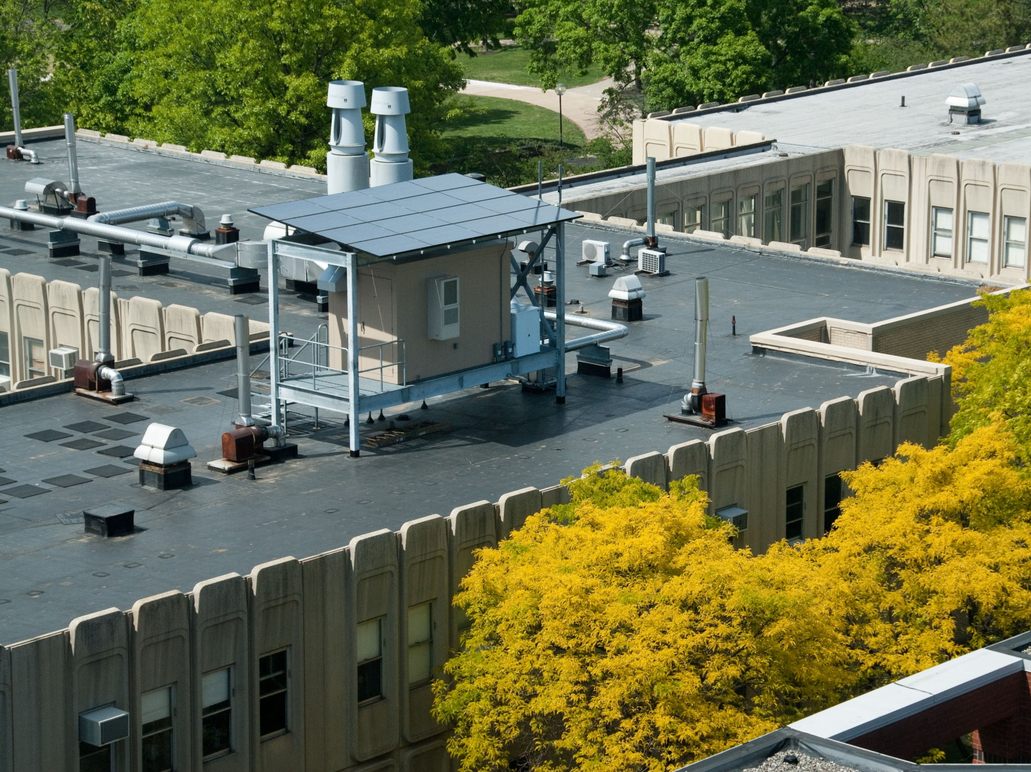
Datacenters: State-of-the-art
“Parasol and Greenswitch: Managing datacenters powered by renewable energy”

Slide 8
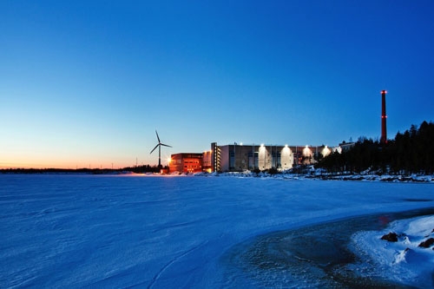
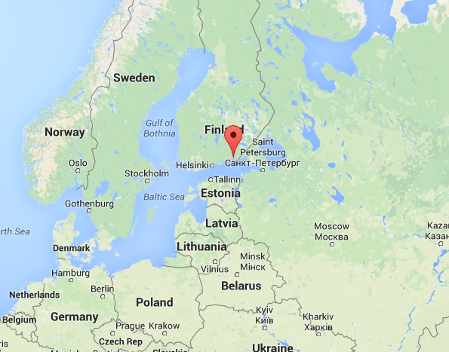
Datacenters: State-of-the-art
Google datacenter in Finland

Slide 9
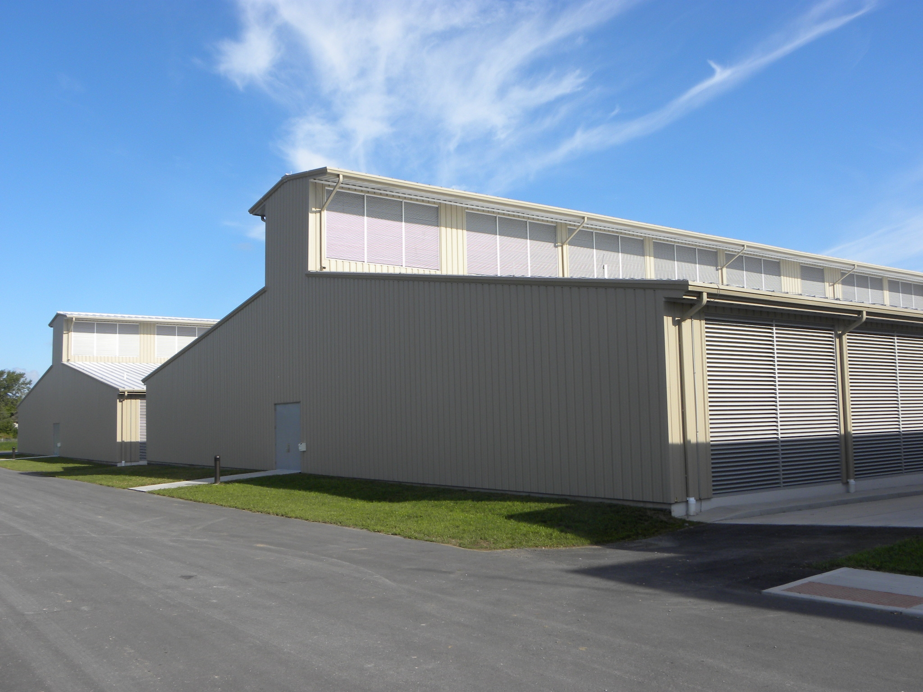
Datacenters: State-of-the-art
Yahoo datacenter

Slide 10
Datacenters: Majority
Small to medium datacenters
Responsible for more than 70% of the entire electrical power used by datacenters
Still labor under heavy cooling overhead about 50%
More demand: private cloud

Slide 11
Datacenter Cooling Essentials
Motivation
Our Approach: ATAC
Evaluation
11
11
Notes:
11
11

Slide 12
Datacenter Cooling Essentials
Two things
Control algorithms for cooling units
Cool air delivery time
12

Slide 13
Datacenter Cooling Essentials (1)
Static control algorithm
Always supplies cool air based on worst case scenario
Not efficient
Dynamic control algorithm
Starts from static control algorithm
While all servers are under emergency temperature, raises room temperature
When any server experiences emergency temperature, lower room temperature
13

Slide 14
Datacenter Cooling Essentials (2)
Feeling
Hungry
Order a Pizza
Remain hungry!
14
Cool air delivery time
Why is it important?

Slide 15
Datacenter Cooling Essentials
Hottest server
Cooling unit
15

Slide 16
Datacenter Cooling Essentials
Inlet air temperature < Emergency temperature
Hot
16

Slide 17
Datacenter Cooling Essentials
Temperature margin is required
for all dynamic control algorithms!
Inlet air temperature > Emergency temperature
!
Hot
17

Slide 18
Datacenter Cooling Essentials
Motivation
Our Approach: ATAC
Evaluation
18
18
Notes:
18
18

Slide 19
ATAC ▷ Motivation I
Thermal overshooting
Non-zero delivery time of cool air
Inlet air temperature > T_{emergency}
About 1% of the time
19

Slide 20
ATAC ▷ Motivation II
Thermal overshooting
Only for the small numbers of servers
20

Slide 21
ATAC ▷ Motivation
Goal
Keep CPU temperature under the target temperature even when T_{inlet air} > T_{emergency}
Non-zero delivery time of cool air
Potential solutions should
perform locally AND
take inlet air temperature into account
Only for the small numbers of servers
21

Slide 22
Datacenter Cooling Essentials
Motivation
Our Approach: ATAC
Evaluation
22
22
Notes:
22
22

Slide 23
Our approach: ATAC
Fans = Max
23
Experiments: Server power vs. Inlet air temperature

Slide 24
Our approach: ATAC
Core temperature can be under the control
even after T_{emergency}
Linear model
24
Repeating experiments with different configurations

Slide 25
Our approach: ATAC
ATAC is a system-level technique
Throttles performance when T_{inlet air} > T_{emergency}
Any theory that explains our experiments?
Fan affinity laws ^{[22]}
Watts (heat transfer) ∝ ΔTemperature × Amount of air
constant
CPU power ∝ (T_{core} － T_{inlet air})
Old CPU Power
New CPU Power
＝
Old ΔTemperature
New ΔTemperature
25

Slide 26
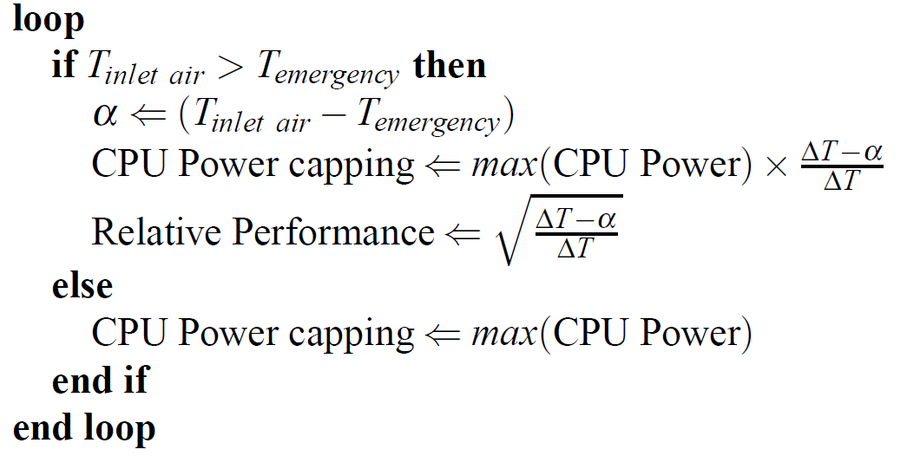
ATAC: Algorithm

Slide 27
ATAC ▷ Configurables
Aggressive ATAC
ATAC compromises performance to reduce CPU power consumption.
How aggressively?
ATAC－#
ATAC－0
Lower CPU performance when T_{inlet air} = T_{emergency}
ATAC－X
Lower CPU performance when T_{inlet air} = T_{emergency} －X
27

Slide 28
Datacenter Cooling Essentials
Motivation
Our Approach: ATAC
Evaluation
28
28
Notes:
28
28

Slide 29
ATAC ▷ Simulation Setup
Racks
CRAC
Hot Aisle
Cold Aisle
Racks
Hot Aisle
Raised Floor
(a) Bird's-eye view
(b) Top view
29

Slide 30
ATAC ▷ Simulation Setup
Google cluster data (GCD)
select 5 days
12,800 processing cores
50 blade chassis
16 servers per blade chassis
16 processing cores
AMD Opteron 6386 SE, 140W TDP
30

Slide 31
ATAC ▷ Evaluation
Baseline
Dynamic cooling control T_{emergency} ＝ 40ºC that targets T_{core} ≤ 80ºC
No safety margin
Failed because of non-zero cool air delivery time
31

Slide 32
ATAC ▷ Evaluation
ATAC, DTM, Power capping, and PowerNap
32

Slide 33
ATAC ▷ Evaluation
ATAC, DTM, Power capping, and PowerNap
33

Slide 34
ATAC ▷ Key Contributions
Ambient temperature-aware thermal control
No need for the safety margin
38% saving in cooling power
Negligible performance degradation
<1%
34

Slide 35


ATAC: Ambient Temperature-Aware Capping for Power Efficient Datacenters
Sungkap Yeo
Mohammad M. Hossain
Jen-cheng Huang
Hsien-Hsin Sean Lee
Georgia Tech
MARS Lab
http://arch.ece.gatech.edu
Notes:
35

